Slide 1

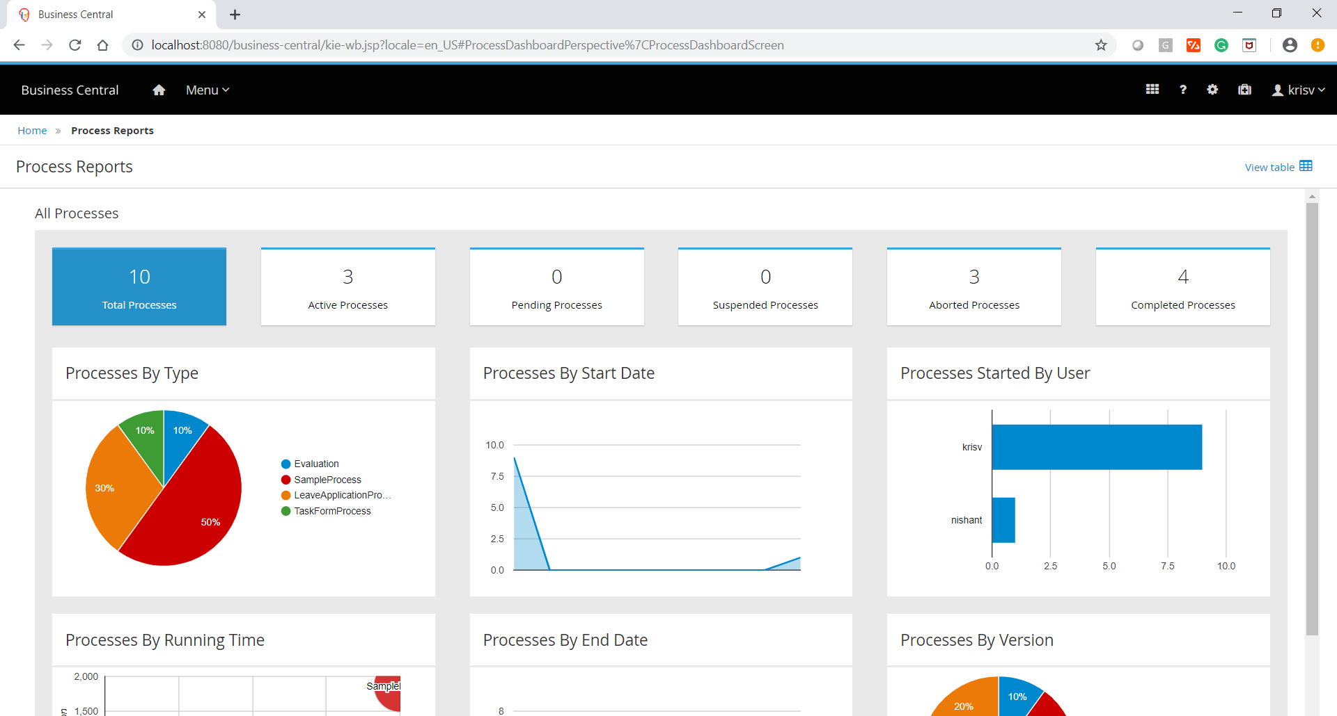
Business Activity Monitoring
Notes:
Working with the jBPM console

Slide 2
Agenda
01
02
03
Reporting
Direct Intervention
Quiz
04
Conclusion

Slide 3
Reporting

Slide 4

Reporting
Process Reports
Task Reports

Slide 5
Direct Intervention

Slide 6

Quiz
Business Activity Monitoring

Slide 7
Quiz
Process Reports are available under which section from below list?
Design
Deploy
Track
Manage

Slide 8

Answers
Process Reports are available under which section from below list?
Design
Deploy
Track
Manage

Slide 9
Quiz
Business Activity Dashboards can be designed into external applications
True
False

Slide 10
Answers
Business Activity Dashboards can be designed into external applications
True
False

Slide 11
Conclusion

Slide 12


Summary
In this session, you have learnt:
Reporting
Direct Intervention

Slide 13

India : +91-7847955955
US : 1-800-216-8930 (TOLL FREE)
support@intellipaat.com
24X7 Chat with our Course Advisor
Notes:
Thank you!

